Slide 1

GCIS-124
Software Development & Problem Solving
6: Data Structures II

Slide 2





Data Structures II
In this unit we will continue exploring abstract data types and data structures.
An abstract data type describes the behavior of a data structure from the perspective of its user without providing any implementation details.
Every abstract data type (ADT) may be implemented in more than one way.
When solving a new problem, choosing the most efficient implementation is just as important as choosing the correct data structure.
We will examine several different abstract data types and implement each of them in at least one way including:
Binary Trees
Binary Search Trees
Heaps
Comparable/Comparators
Tree Sets & Tree Maps
We will begin by focusing on a new data structure: the binary tree.
You are already familiar with many data structures from the perspective of a user including arrays, queues, stacks, lists, sets, and dictionaries.
In this unit we will learn how different implementations of many of these data structures work.
We will also examine the situational strengths and weaknesses of each implementation in terms of complexity (both space and time).

Slide 3


Review: Abstract Data Types
A data structure is a grouping of related data.
We refer to the data as elements.
Most data structures provide some common operations including store, retrieve, remove, and size.
An abstract data type (ADT) defines the behavior of a data structure from the point of view of its user.
This includes the possible values and the operations available.
Choosing the ADT that provides operations suitable for solving a problem usually isn't enough.
Each ADT may be implemented in multiple ways.
Choosing the correct implementation is also important.
This requires understanding the complexity of each operation under different circumstances.
Choosing the correct abstract data type involves understanding the nature and constraints of the problem being solved.
Choosing the correct implementation involves understanding which operations will be used the most and which of the available options provides the most efficient implementation of those operations.

Slide 4

Gotta Catch 'em All!
Pokémon trainers use a Pokédex to keep track of the Pokémon that they have captured.
When encountering a Pokémon in the wild, it’s important for a trainer to know whether or not they have already captured that species.
In order to implement the Pokédex, we will need a data structure that meets the following requirements:
Quickly search to determine whether or not a specific Pokémon is already in the collection.
Print all of the Pokémon in our Pokédex in order by number.
What is the best data structure to use that meets both of those requirements?
I need to know if it’s worth using my last Razz Berry and an Ultra Ball or not.

Slide 5

The Pokédex as a List
Simply add each Pokémon to the end of the list as it is captured.
This is a constant time (O(1)) operation.
How will you determine whether or not you have captured a specific Pokémon when you encounter it in the wild?
Perform a linear search; an O(N) operation.
What is the complexity of maintaining the Pokédex over time?
Each time you encounter a Pokémon, you will perform a linear search (O(N)).
The complexity over time will be O(N²).
How will you print the Pokémon in order?
Search the list for the Pokémon with the next smallest number.
To print N Pokémon, you will need to perform N linear searches; again O(N²).
There is probably a better way.
What if we try to keep the list in sorted order?
Notes:
Complexity of maintaining
For N pokeman, for each you have to search N times. For N it becomes N2

Slide 6
The Pokédex as a Sorted List
Keep the list in sorted order.
Each time a new Pokémon is added, insert it into the correct position in the list.
This will allow you to perform a binary search to determine whether or not you have already captured a Pokémon.
This is an O(log₂N) operation.
What is the complexity of searching the Pokédex over time?
Each time you encounter a Pokémon, you will perform a binary search.
The complexity over time will be O(Nlog₂N). Much improved!
Printing the Pokemon in order is as simple as iterating over the list, an O(N) operation! Another big improvement!
But what is the complexity of keeping the list sorted?
Each insert is an O(N) operation.
You will perform an insert N times; O(N²). Ugh.
Next!
What if we used a fast data structure like a Python dictionary?

Slide 7
The Pokédex as a Dictionary
Why not use a dictionary to keep track of your captured Pokémon?
Use the Pokémon’s number as the key.
Adding a new Pokémon is a constant time (O(1)) operation.
Searching for a Pokémon is also a constant time (O(1)) operation.
But what about printing the Pokémon in order by number?
Dictionaries do not maintain the keys in a predictable order.
This means that you’d have to iterate over the keys looking for the Pokémon with the next smallest number; a O(N) operation.
And to print N Pokémon, you’d have to do the linear search N times; O(N²). Gross.
Alternatively, you could copy all of the Pokémon into a list and sort them: O(N+Nlog₂N). Better, but not great.
If we want to avoid a lot of slow operations, it seems like we’ll need a new data structure to solve this problem.

Slide 8
Pokédex Options
Let's look at the data structures we already know and consider the complexity to:
Add a Pokémon to the Pokédex.
Determine if a Pokémon is already in the Pokédex.
Add N Pokémon to the Pokédex.
Print the Pokédex in order
List
Sorted List
Dictionary
Add
O(1)
O(N)
O(1)
Find
O(N)
O(log₂N)
O(1)
Add N
O(N)
O(N²)
O(N)
Print
O(N²)
O(N)
O(N+Nlog₂N)
We have learned several options for storing data but none of them are great for this problem.

Slide 9
Binary Trees… What Are They Even?
A binary tree is one of two things...
An empty tree...
A non-empty tree...
12
?
?
Can you see it? It’s right there...
A non-empty tree includes a value and a left subtree and a right subtree, either or both of which may be empty.
The empty tree is a tree with no data, and no sub-trees.
The empty tree is represented using null.

Slide 10
Parts of a Binary Tree
A non-empty tree comprises at least one node.
A leaf is a node whose left and right subtrees are both empty.
An internal node is a node that is not a leaf.
12
12
12
15
11
In diagrams, a node is represented as a circle.
The arrows are not drawn for empty subtrees.
That is to say that one or both of its subtrees is not an empty tree.
The value is written inside the circle.
These subtrees may also be referred to as empty nodes and are represented using null.
The subtrees are indicated using arrows.

Slide 11
Parts of a Binary Tree
A node c is a child of another node p if it is the left or right subtree of p.
A node p is a parent of another node c if c is one of its subtrees.
The root node is a node that has no parent.
5
7
5
3
7
6
9
3
7
1
4
6
9
In this example, 6 is a child of 7 because 6 is the left subtree.
In this example, 5 is the parent of 7 because 7 is the right subtree of 5.
In this example, 5 is the root node because it has no parent.
9 is also a child of 7 because 9 is the right subtree of 7.
5 is also the parent of 3 because 3 is its left subtree.
There is only one root node in a binary tree.

Slide 12
6.1
A Binary Node
You should remember the Node class that we wrote and used to implement the NodeStack and NodeQueue. Now we’re going to create a similar class to represent a node in a binary tree: BinaryNode.
2
Create a new class called BinaryNode.
The class should have the following methods:
A least one constructor that takes an int value.
A getter/setter for its int value.
A getter/setter for its left subtree (a BinaryNode).
A getter/setter for its right subtree (a BinaryNode).
A toString() that returns a String in the format: "BinaryNode{value=<value>, left=<left>, right=<right>}"
Add a main method and build the binary tree shown on the left. Print it to standard output.
3
7
9
4
1
6

Slide 13

Printing the Pokédex
The next part of the Pokédex problem is to print all of the Pokémon in the Pokédex in order by number.
This will require us to stringify the binary tree that implements our Pokédex.
“Stringify” is a technical term that I totally did not just make up that refers to making a string from the values in the tree.
Converting a binary tree into a string requires that we:
Visit each node in the tree.
Add its value to a string using concatenation.
The process of visiting each node in a tree is also referred to as traversing the tree.
I’d like to brag about all of the Pokémon that I’ve captured!

Slide 14
Infix (in-order ) Traversal
There is more than one way in which to traverse a binary tree; the order in which the nodes are visited, and therefore the results, may change.
Consider the binary tree to the left. If you wanted to print all of the node values in increasing numerical order, in which order would you need to visit each node?
First, visit the left subtree.
Then, visit the middle node.
Finally, visit the right subtree.
This is called an infix traversal or sometimes an in order traversal.
The nodes are always visited in the order: left-middle-right.
5
3
7
1
4
6
9
Consider how changing the order in which the nodes are visited would change the string we are building.
There are other kinds of traversal that change the order in which the middle node is visited.

Slide 15
A Closer Look at Infix Traversals
Traversing a tree refers to visiting each of the nodes in the tree, i.e. doing something with the value in each node such as appending it to a string or adding it to a sum.
An infix traversal starts at the root, but visits the left subtree first.
The same is true of any node that has subtrees… the left subtree is visited first.
5
The type of traversal determines the order in which the nodes are visited.
# 4
And I'll be very last because the right subtree is visited last.
A traversal always starts at the root, but doesn't necessarily visit the root first.
That means that I am the very first node to be visited!
3
7
# 2
# 6
An infix traversal always visits the left subtree first, then the middle node, then the right subtree last.
1
4
6
9
# 1
# 3
# 5
# 7

Slide 16
6.2
An Infix (in-order) Traversal
It's important that we be able to convert a Binary Tree into string that we can read and understand so that we can examine the contents of the tree as we manipulate it. Let's implement a method to perform an infix traversal of the tree and returns it as a string.
2
Open the BinaryNode class and define a method named "infixTraversal" that returns a String.
Create an empty String.
If the left subtree is not null, call its infixTraversal method and add the return value to the string.
Then the node should visit itself - add the value to the string followed by a space, e.g. "5 ".
If the right subtree is not null, call its infixTraversal method and add the return value to the string.
Return the string!
Update the main method in your BinaryNode to call the infixTraversal method on the root of the tree that you built previously. Print the resulting string.
It should print the string: 9 3 4 2 1 7 6
3
7
9
4
1
6
The order is all wrong! How do we make sure that the nodes print in the correct order?
We will discuss that soon!

Slide 17
Searching a Binary Tree
Once the values are added to a binary tree, how would we search the tree to determine whether or not it contains a specific value?
Binary trees are a recursive data structure, so it should come as no surprise that a recursive algorithm can be used to search a binary tree beginning with the root node.
If the node's value matches the target, return true.
Otherwise, if the left subtree is not null, search it. If the target is found, return true.
Otherwise, if the right subtree is not null, search it. If the target is found, return true.
Otherwise, return false.
Determining whether or not a value is present in a binary tree requires a search.
A
2
Q
6
Z
Q
2
If the target is not in the root node, search one of the subtrees.
If the target still is not found, search the other subtree.

Slide 18
6.3
Searching a Binary Tree
Because the values in a Binary Tree are not in any particular order, searching means that, if the target doesn't match the value in a node, you may need to search both the left and right subtrees. Try implementing a search algorithm now. What is the time complexity when searching a binary tree with N nodes?
2
Open the BinaryNode class and define a new method with the signature: public boolean search(int target)
If the node's value matches the target, return true.
Otherwise, search the left subtree, and return true if the target is found.
Otherwise, search the right subtree, and return true if the target is found.
Otherwise, return false.
Update the main method to search for several values and print the results.
3
7
9
4
1
6
Make sure to search for values in both subtrees as well as values that are not present in the tree.
Notes:
We don’t know how many nodes are there. So a recursive search is good approach.

Slide 19
Search Complexity
What is the average complexity of searching a binary tree with N nodes?
Because there is no predictable order to the values in the tree, both subtrees need to be searched.
On average, about half of the nodes will need to be searched, so O(½N) or just O(N).
This is no better than a linear search! Is there a way that we can improve the efficiency of searching a binary tree?
A binary search runs in logarithmic time O(log₂N) because it eliminates half of the values with each iteration; it chooses to search only the left half or the right half of an array.
Is there a way to arrange values in a binary tree to accomplish the same thing?
A binary tree is any tree with the structure described previously.
A
2
Q
6
Z
Q
2
Each node has two children: a left subtree and a right subtree.
There is no relationship between the data in the nodes.

Slide 20
Binary Search Trees (BSTs)
Assuming that the values in a binary tree can be arranged into some natural order, we can build the tree so that it is more efficiently searchable.
Each time a new value is added to the tree:
If the new value comes before the root’s value in natural order, then it is added to the left subtree.
If the new value comes after the root’s value in natural order, then it is added to the right subtree.
The process continues recursively through each node in the tree until an empty subtree is found.
The new value is added in place of the empty subtree.
A binary search tree (BST) is a special binary tree that has some extra rules.
5
2
7
1
3
6
9
From any node in the tree, the left subtree contains only values that come before...
...and the right subtree contains only values that come after.

Slide 21
Identifying Binary Search Trees
Is this a Binary Search Tree? If not, why not?
25
25
15
50
12
60
10
22
35
14
51
70
4
12
18
24
31
44
13
24
31
63
66
90

Slide 22
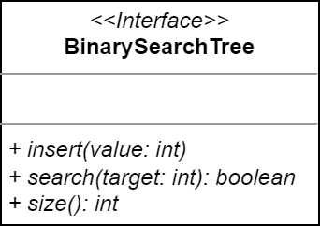
6.4
A Binary Search Tree ADT
Remember, an ADT tells us what a data structure does, but not how it does it - it defines behavior without implementing it. We will need to define an abstract data type (ADT) to represent a binary search tree (BST) using a Java interface.
Using the UML to the left, define a new Java interface to represent a binary search tree.
For now, the BST will only work with integer values.

Slide 23
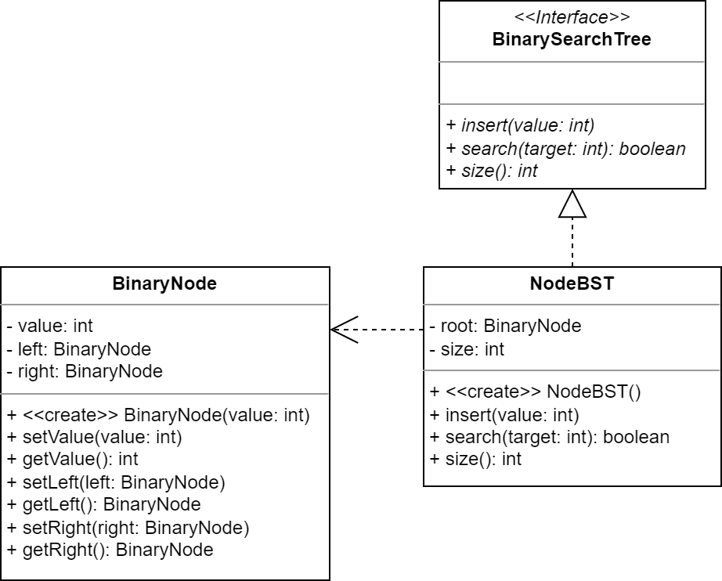
6.5
A Node-Based BST
As you know, most ADTs can be implemented in more than one way. Let's work on a node-based implementation of a BST using the BinaryNode!
Using the UML to the left, begin implementing the NodeBST class.
Use the constructor to set the root node to null.
Implement the size() method just like we have for most of our data structures.
Stub out the other methods for now.
The string representation of the NodeBST should be an infix traversal of the tree, or "<empty>" if the tree is empty.
Define a main method with the appropriate signature and use it to create an empty NodeBST and print it to standard output.

Slide 24
Inserting into the Pokédex
So now that we know that we can implement the Pokédex using a binary search tree, how do we go about adding a new Pokémon to the Pokédex?
Each new Pokémon will need to be inserted into the correct position in the BST.
Again, because a BST is a recursive data structure, a recursive algorithm can be used.
Starting at the root, if the new value comes before the node's value, insert the new value into the left subtree.
Otherwise, insert the new value into the right subtree.
Repeat this until an empty subtree is found. Create a new BinaryNode and add it to the tree.
Once I’ve captured a new Pokémon, I need to insert it into my Pokédex!

Slide 25
A Closer Look at Inserting into a BST
The root node in an empty BST is null, so the first value inserted becomes the root.
If the next value is less than the root's value, it is inserted into the left subtree.
As new values are inserted, the process continues recursively; each value is inserted into the left or right subtree until an empty subtree is found.
25
At this point, the left subtree is empty, and so the new value becomes the left subtree.
25
12
37
25
5
14
35
41
12
37
3
9
36
If the next value is greater than the root's value, it is inserted into the right subtree.
4

Slide 26
6.6
Practice Drawing BSTs
Drawing diagrams can help understand how something works. Let's practice inserting into binary search trees by drawing a few pictures!
When inserting into a binary search tree, if the tree is empty, the value becomes the root. For each additional value:
If the value is less than the root, insert into the left subtree.
If the value is greater than the root, insert into the right subtree.
Recurse until an empty subtree is found; the new value becomes the subtree.
Try it now with the following sets of values:
5, 7, 6, 2, 9, 1, 3
5, 4, 6, 3, 7, 2, 8, 1, 9
10, 15, 20, 25, 30, 35, 40
10, 9, 8, 7, 6, 5, 4, 3, 2, 1
5
2
7
1
3
6
9
Get out a pen or pencil and some paper and draw a few trees!

Slide 27
6.7
Inserting into a Binary Search Tree
Building a BST requires inserting new values into a node's left subtree if they are less than the the node's value, and into the right subtree otherwise. This continues until an empty subtree is found. Try implementing binary insert now!
Open the NodeBST and define a private helper function named binaryInsert that declares a parameter for a BinaryNode node and an int value to be inserted.
If the value is less than the node's value:
If the left subtree is empty, make a new BinaryNode with the value and make it the left subtree.
Otherwise, use recursion to insert the value into the left subtree.
If the value is greater than the node's value:
If the right subtree is empty, make a new BinaryNode with the value and make it the right subtree.
Otherwise, use recursion to insert the value into the right subtree.
Navigate to the insert method.
If the root node is null, create it using the value.
Otherwise, call binaryInsert with the root and the value.
Don't forget to increment size!
4
2
6
1
3
5
7
Use main to build the tree depicted above and print it to standard output.

Slide 28




























































Available Pokémon
039
004
147
075
129
008
146
020
026
036
132
093
001
145
174
050
196
003
151
019
470
009
051
054
130
144
052
006
076
094
074
197
053
025
136
002
035
143
134
055
065
005
113
149
173
172
064
133
446
471
150
242
007
148
063
135
700
013
092
040

Slide 29
6.8
Building Your Pokédex
We'll be using a Binary Search Tree (BST) inside of a Pokédex that stores the number of any Pokémon that we encounter in the wild. As each Pokémon is encountered, its number will be inserted into the BST. When we are finished, we can print all of the stored Pokémon in order!
Use the UML to the left to implement a Pokédex class that uses a BST to provide the following behavior:
A Pokédex is constructed empty. How should you represent an empty BST?
addPokémon - inserts the Pokémon's number into the Pokédex.
toString - returns all of the Pokémon contained in the Pokédex in order.
Define a main method.
Create an empty Pokédex and add 15 of the Pokémon from the previous table in the order that they appear in the table.
Print the Pokédex to standard output.
Pokédex
- bst: BinarySearchTree
+ <<create>> Pokédex() + addPokémon(number: int): void + toString(): String

Slide 30
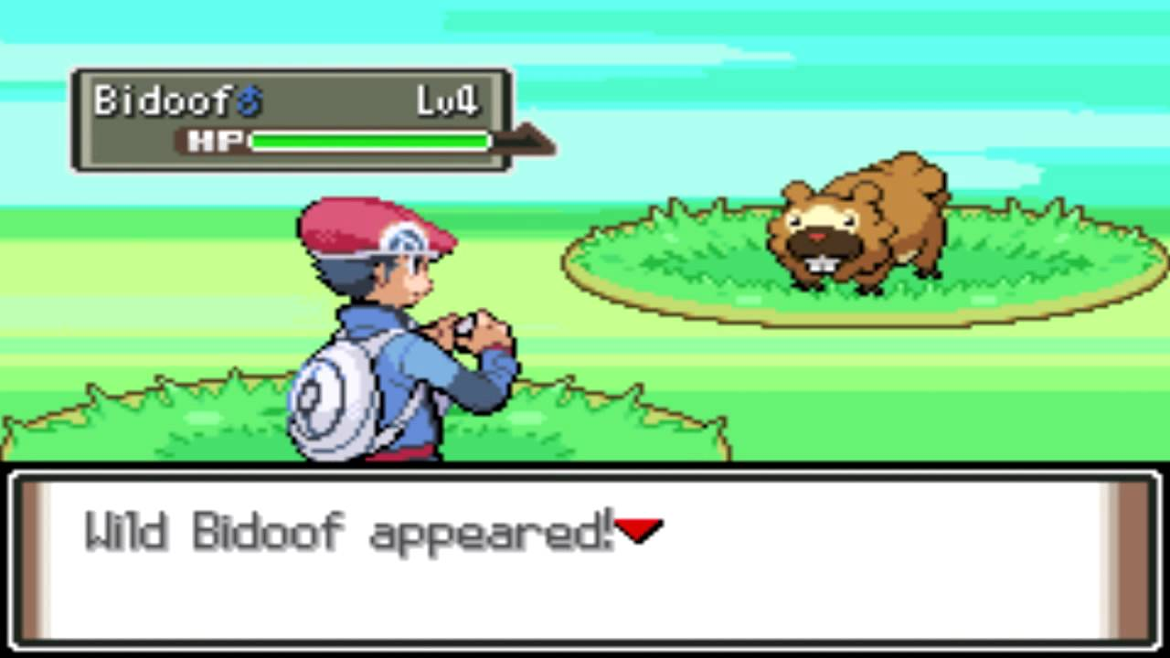
Searching the Pokédex
Each time a new Pokémon is encountered, it is essential that we can quickly search the Pokédex and determine whether or not we’ve already captured a Pokémon of that species.
It should come as no surprise that there is a recursive algorithm for searching a BST that is only a little different from the algorithm to search a plain binary tree starting at the root node.
If value matches the target, return true.
If the target is less than value, search the left subtree.
Return false if the left subtree is null.
Otherwise, search the right subtree.
Return false if the right subtree is null.
Ah, the rare and elusive Bidoof. Do I already have one of these?
The old search method blindly searches the left subtree and then the right. It doesn’t pay attention to the relationship between the value and the target.
In a plain binary tree, this is the only option. But in a BST, we can search much more efficiently.

Slide 31
A Closer Look at Searching a BST
Like all other BST operations, searching a BST for a target value starts at the root of the tree.
target = 25
Hey! I found it!
25
If the target value is equal to the root's value, return true.
15
50
10
22
35
4
12
18
24
31
44

Slide 32
A Closer Look at Searching a BST
12 is less than 25, so search my left subtree!
If the target value is less than the root, the left subtree is searched.
target = 12
12 is less than 15, so search my left subtree.
This continues recursively until the target is found.
25
12 is greater than 10, so search my right subtree.
50
If, at any point, the target is greater than the node's value, the right subtree is searched.
15
10
22
35
This continues until the target is found.
Found it!
If the corresponding subtree is empty (i.e. null), the target is not found.
4
12
18
24
31
44

Slide 33
6.9
Searching a BST
Values in a Binary Search Tree (BST) are organized such that the left subtree only contains values that are less than a node's value, and the right subtree only contains values that are greater than the node's value. Because of this, a search of the BST is able to make a decision about which subtree to search (just like Binary Search). Let's implement a binary search now!
Begin by creating a private helper function named binarySearch that declares parameters for a BinaryNode node and an int target.
If the target is equal to the node's value, return true.
If it is less than the node's value, recursively search the left subtree.
Otherwise, recursively search the right subtree.
If you find an empty subtree, return false.
Implement the search method by calling the binarySearch method with the root and the target and return the result.
Use the main method to search for at least 4 values, 2 of which are not in the tree.
4
2
6
1
3
5
7
A search through a BST will be able to make decisions about which subtrees to search.

Slide 34
6.10
Searching Your Pokédex
It's not enough to simply add Pokémon to the Pokédex as they are encountered - the Pokémon Trainer also wants to be able to quickly determine whether or not a Pokémon is already in the Pokédex so that they can decide whether or not it is worth taking the time to try and catch it!
Enhance the Pokédex class so that it also provides the following behavior:
containsPokémon - returns true if the Pokémon's number is already in the Pokédex, and false otherwise.
addPokémon - update the method so that it should only add a Pokémon to the Pokédex if it is not already present.
Use the main method to search for several Pokémon and print the results to standard output.
Make sure to search for Pokémon that are in the Pokédex as well as those that are not.
What happens if you try to add the same Pokémon twice?
Pokédex
- bst: BinarySearchTree
+ <<create>> Pokédex() + containsPokémon( number: int): boolean + addPokémon(number: int): void + toString(): String

Slide 35
Balance
A binary tree is balanced if the left and right subtrees are both bushy and about equally so.
A binary tree is unbalanced if there are more nodes in one half of the tree than the other.
In the extreme case, an unbalanced tree becomes a list.
9
5
5
7
3
7
3
7
6
1
4
6
9
2
4
6
5
1
This means that there are approximately the same number of nodes in both halves of the tree at every level.
4
Unbalanced trees are more branchy than bushy.
3

Slide 36
Complexity of Searching
The complexity of searching a binary search tree depends on how balanced the tree is.
A balanced tree has the same number of nodes in the left subtree as it has in its right subtree at every level.
These trees are referred to as bushy.
An unbalanced tree has more nodes in one subtree than the other.
These trees are referred to as branchy.
The extreme case is a list.
If a BST is balanced, a search eliminates half of the nodes in the tree with each iteration, just like a binary search; the complexity is O(log₂N).
If the BST is unbalanced, the performance approaches linear time (O(N)).
5
3
7
1
4
6
9
Each iteration eliminates half of the nodes in a balanced tree. The complexity is therefore O(log₂N) (just like binary search).
9
7
6
5
4
3
In the extreme case in an unbalanced tree, every node is searched: O(N).

Slide 37







Determining Order
Sorting numbers is easy.
You either sort them in ascending order from smallest to largest, or descending order from largest to smallest.
Sorting strings is also easy. Sort of.
Most humans like to sort strings alphabetically, e.g. "apple", "Cat", "monkey", "Zoo".
Most computers like to sort them lexicographically, which is in ascending order by ASCII value, e.g. "Cat", "Zoo", "apple", "monkey".
But what about sorting other types of things?
Like fruits, or dogs, or goats, or trolls?
Or the symbols in an alien language?
We already know how to compare arbitrary objects for equality.
We use the equals(Object) method that is inherited from the Object class.
The default implementation compares the identity of the two objects, but we can override that.
That's great, but knowing whether or not two objects are equal to each other tells us nothing about which one comes first in sorted order.
SORT THESE alien SYMBOLS, HUMAN, OR IT'S BACK TO THE PROBE CHAMBER!
not the probe chamber?!
It's easy enough to see that two symbols aren't equal, but how do we tell which comes first?

Slide 38

Comparable
The easiest way to sort values of some type is if they are naturally comparable to each other.
The type defines its own natural order.
That is to say, given two values of the same type, you can compare one to the other to determine which comes first.
In Java, a type is made naturally comparable by implementing the java.lang.Comparable interface.
Comparable is a generic interface that defines a type parameter T. This is used to specify the type to which the class can be compared.
A class usually specifies its own type in place of the type parameter.
The Comparable interface defines a single method: public int compareTo(T other)
Given two instances of a comparable class A and B, A.compareTo(B) returns:
0 if A and B are equal to each other.
< 0 if A comes before B in sorted order.
> 0 if A comes after B in sorted order.
can you tell me which of you guys comes first in sorted order?
he does!
i do!
If a class implements Comparable, then you can directly compare two instances of the class using the compareTo(T) method to see which comes first in sorted order.

Slide 39
A Closer Look at Comparable
A class implements Comparable to define its own natural order, which determines how instances of the class will be arranged in sorted order.
1 public class AlienAlphabet implements Comparable<AlienAlphabet> {
2 private final int sequenceNumber;
3 private final String symbol;
4
5 public AlienAlphabet(int sequenceNumber, String symbol) {
6 this.sequenceNumber = sequenceNumber;
7 this.symbol = symbol;
8 }
9
10 @Override
11 public int compareTo(AlienAlphabet other) {
12 // sort by sequence number
13 return this.sequenceNumber - other.sequenceNumber;
14 }
15 }
Comparable is a generic type. Its type parameter determines the type of value that can be passed into the compareTo(T o) method.
Most of the time, a class wants to be compared with its own type, and so it will specify its own type in place of the type parameter.
When A.compareTo(B) is called on an instance it should return <0 if A comes before B in sorted order, 0 if A and B are equal, and >0 if A comes after B.

Slide 40
6.11
Comparable Pokémon
Right now we are representing a Pokémon using its number. But there is a lot more to Pokémon than a mere number - each Pokémon should also at least have a name! Let's create a new class to represent Pokémon and implement it so that Pokémon are naturally comparable by number.
public class Alien implements Comparable<Alien> {
private final int seqNumber;
private final String symbol;
public Alien(int seqNumber, String symbol) {
this.seqNumber = seqNumber;
this.symbol = symbol;
}
@Override
public int compareTo(Alien other) {
// sort by sequence number
return this.seqNumber - other.seqNumber;
}
}
Create a new Java class named "Pokémon".
Add fields and a constructor for the Pokémon's number and name.
Override toString() to return a String in the format "#: <name>", e.g. "7: Squirtle".
Implement the Comparable interface.
The class should specify its own type for the generic type parameter.
Compare two Pokémon using their numbers in ascending order.
Remember, poke1.compareTo(poke2) should return an integer that is <0 if poke1 is first, 0 if they are equal, and >0 if poke1 is second.
Add a main method with the appropriate signature.
Create a Java List that contains at least 3 different Pokémon. Make sure to add them out of order.
Call the Collections.sort(List) method to sort the list and then print it to standard output.
Up until now we have been representing Pokémon using integers.
Let's create a class that defines its own natural order instead.

Slide 41

Comparators
If a class implements Comparable, it defines its own natural order and can be sorted.
By using Collections.sort(List) for example.
But what do you do if a class doesn't implement Comparable and you would still like to arrange objects of the class into some order?
Or what if the class does implement Comparable but you want to arrange objects into some other order?
Java provides another interface that allows you to create a helper class that can be used to arrange objects of some other class: java.util.Comparator.
It is a generic type that defines a single method, compare(T a, T b), that compares two instances of some other class.
It follows the same rules as Comparable and returns an integer <0 if a comes before b in sorted order, 0 if a and b are equal, and >0 if a comes after b.
A class that implements Comparator acts as a helper to sort objects of another type.
can you tell me which OF you guys comes first in sorted order?
WE HAVE NO IDEA.
i can help!
A Comparator is a separate class that can compare instances of some other class. It can help sort things that do not have a natural order or sort them in a different way if they do.

Slide 42
A Closer Look at Comparator
A class that implements Comparator defines a sort order for some other class, which is specified for the Comparator's type parameter.
1 public class AlienComparator implements Comparator<AlienAlphabet> {
2
3 @Override
4 public int compare(AlienAlphabet o1, AlienAlphabet o2) {
5 String sym1 = o1.getSymbol();
6 String sym2 = o2.getSymbol();
7 return sym1.toLowerCase().compareTo(sym2.toLowerCase());
8 }
9 }
A Comparator is needed when the other class does not define a natural order at all or to sort instances of the class in some other way.
The other class is specified in place of the type parameter, and determines the parameter types for the compare(T o1, T o2) method.
It's worth noting that String, like many other Java types, implements Comparable to define its own natural order. This means that you can use its compareTo(String) method in your own classes.
When C.compare(A, B) is called on the Comparator it should return <0 if A comes before B in sorted order, 0 if A and B are equal, and >0 if A comes after B.

Slide 43
6.12
Pokémon Comparator
Pokémon define a natural order that sorts them in ascending order by number. That's great! But what if we wanted to sort them them in some other way, e.g. alphabetically by name? We'd need a separate Comparator class that will help Java's sorting algorithms to arrange the Pokémon in a different way, other than the natural sorting that we defined in the previous activity.
public class AlienComp
implements Comparator<Alien> {
@Override
public int compare(Alien o1, Alien o2) {
String sym1 = o1.getSymbol();
String sym2 = o2.getSymbol();
return sym1.toLowerCase().
compareTo(sym2.toLowerCase());
}
}
Create a new Java class named "PokémonComparator".
Implement the Comparator interface.
Specify Pokémon as the comparable type. Both parameters to the compare(T o1, T o2) should therefore also be Pokémon.
Compare two Pokémon alphabetically by name.
Remember, comp.compare(poke1, poke2) should return an integer that is <0 if poke1 is first, 0 if they are equal, and >0 if poke1 is second.
Define a main method with the appropriate signature.
Create a Java List that contains at least 3 different Pokémon. Make sure to add them out of order.
Call the static Collections.sort(List, Comparator) method to use the PokémonComparator to sort the list and then print it to standard output.
It's great that Pokémon are naturally sortable by number, but what if we wanted to sort them in another way? A Comparator can help with that!

Slide 44
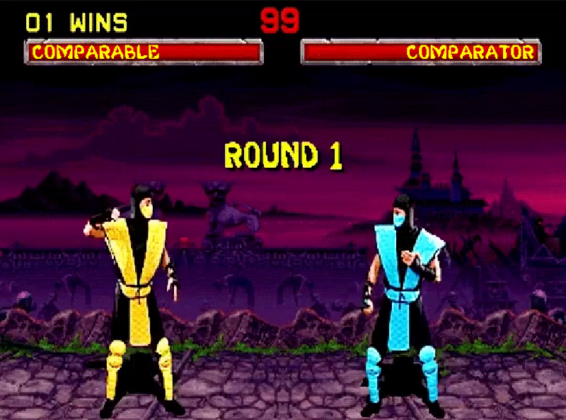
Comparable vs. Comparator
I am an interface implemented by a class that wants to define its own natural order.
I am an interface implemented by a separate class that wants to define an order for some other class.
I am called on one object of the class. Another object is passed in as a parameter, e.g. a.compareTo(b).
This is either because the other class’s natural order doesn’t work for the problem that I am trying to solve or the class doesn’t have a natural order at all.
We are both used for sorting.
The first object compares itself to the second and returns <0, 0, or >0 if the first is before, equal to, or after the second.
We are both used for sorting.
Two instances of the class I can compare are passed into my compare method, e.g. me.compare(a, b).

Slide 45

6.13
Comparable Fruit
It can take a long time to understand the uses of Comparable and Comparator and how they are different from each other. The best way to get a handle on it is to practice implementing both a few times to solve different problems. Let's try another example now!
Create a new Java class named "Fruit".
Every fruit has a name and a price.
Override toString() to return a String in the format "<name> $<price>", e.g. "Apple $1.50".
Implement the Comparable interface.
Implement the compareTo method so that two fruits are compared by name. If two fruits have the same name, compare them by price.
Remember, fruit1.compareTo(fruit2) should return an integer that is <0 if fruit1 is first, 0 if they are equal, and >0 if fruit1 is second.
Add a main method with the appropriate signature.
Create a List with at least 3 fruits. Print it, sort it, and then print it again.
public class Alien implements Comparable<Alien> {
private final int seqNumber;
private final String symbol;
public Alien(int seqNumber, String symbol) {
this.seqNumber = seqNumber;
this.symbol = symbol;
}
@Override
public int compareTo(Alien other) {
// sort by sequence number
return this.seqNumber - other.seqNumber;
}
}

Slide 46

6.14
A Fruit Comparator
If a class does not implement Comparator to define its own natural sorting order or if you need to sort objects of the class in some other way, you will need to create a Comparator to help sort them. Practice now by defining a Comparator that sorts fruits by price.
Create a new Java class named "FruitComparator".
Implement the Comparator interface.
Specify Fruit as the comparable type. Both parameters to the compare(T o1, T o2) should therefore also be Fruit.
Compare two Fruit by price and then name.
Remember, comp.compare(fruit1, fruit2) should return an integer that is <0 if fruit1 is first, 0 if they are equal, and >0 if fruit1 is second.
Add a main method with the appropriate signature.
Create a Java List that contains at least 3 different fruit. Print if, use the FruitComparator to sort it, and then print it again.
public class AlienComp
implements Comparator<Alien> {
@Override
public int compare(Alien o1, Alien o2) {
String sym1 = o1.getSymbol();
String sym2 = o2.getSymbol();
return sym1.toLowerCase().
compareTo(sym2.toLowerCase());
}
}

Slide 47
Heaps
A heap is a another kind of binary tree that is similar to a binary search tree.
Each node in the heap has a value that is an equal or lower priority than the value of its parent.
The exception is the root, which has no parent and always contains the highest priority value.
The horizontal order of the nodes (i.e. from left to right) is arbitrary.
In other words, there is no horizontal relationship between nodes; the left or the right child may be higher priority.
Priority is determined by the specific problem statement.
It is up to the programmer to decide what "highest priority" means, especially when dealing with non-numerical data.
A heap can be organized in one of two ways.
A min-heap organizes values from smallest to largest, and so the root will always have the smallest value in the heap.
A max-heap organizes values from largest to smallest, and so the root will always have the largest value in the heap.
1
1
4
9
3
5
7
An example of a min-heap. Notice that there is no horizontal relationship between nodes.
9
9
7
1
3
5
4
An example of a max-heap.

Slide 48
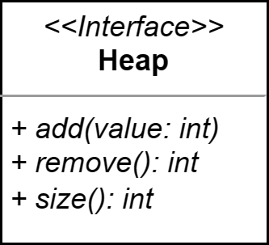
6.15
The Heap Abstract Data Type (ADT)
There is more than one possible way to implement a heap! Like all Abstract Data Types (ADTs), the definition of a heap tells us what a heap can do, but not how it does it. Let's define a Java interface that defines the essential behavior that a heap provides.
Create a "heaps" package, and then use the UML diagram to the left to implement a Heap abstract data type.
When you are finished, verify that you do not have any problems in your project and push your code.
A heap only provides basic operations to add and remove values.

Slide 49
A Heap Overlay
Like many data structures, a heap can be implemented in more than one way.
One obvious way would be to try to implement a heap using binary nodes.
But perhaps there is a way to implement a heap using an array?
The heap can be created using an overlay on an array by adhering to the following rules assuming an array of size N with indices ranging from 0 to N-1.
The root of the heap is at index 0.
Let k be the index of a node in the tree where 0 ≤ k < N.
The left child of node k is located at index 2k+1.
The right child of node k is located at index 2k+2.
For example:
If k is 0, its left child is at 2*0+1 = 1, and its right child is at 2*0+2 = 2.
If k is 11, it's left child is at 2*11+1 = 23, and its right child is at 2*11+2 = 24.
Like other array-based data structures, one challenge is growing the array then it has filled up with values.
This is easier than some other data structures, because the values can be copied into the same indices in a larger array, just like an array list.
7
10
21
50
60
43
24
68
66
Let's look at an example of how this heap would be overlaid onto an array.

Slide 50
An Array-Based Heap
7
7
10
21
50
60
43
24
68
66
10
21
50
60
43
24
68
66
The root is in the first index (0) within the array. Let this be k.
The children of the root are in index 2k+1 (1) and 2k+2 (2).
The children of the left child are at 2k+1 (3) and 2k+2 (4).
The children of the left child are at 2k+1 (7) and 2k+2 (8).
Let k now be the index of the left child: 1.
Now let k be the index of this left child: 3.

Slide 51
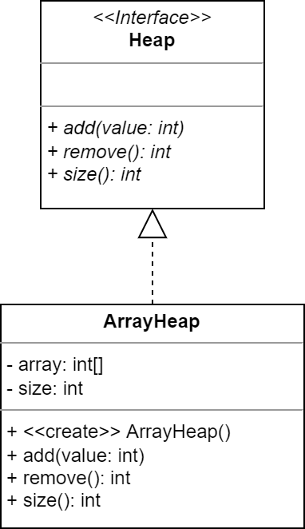
6.16
An Array-Based Heap
Unlike the other trees that we have implemented in this unit, we will not implement the heap using nodes. Instead, we will implement our first heap as an overlay on top of an array.
Using the UML to the left as a guide, begin your array-based implementation of a heap by creating a new Java class named "ArrayHeap" inside the heaps package.
In the constructor:
Initialize the array to a capacity of 3.
Set the size to 0.
Add a toString() in the format "<size>, <array>"
For example: "0, [0, 0, 0]"
Hint: use Arrays.toString().
Implement the size() method.
Stub out the remaining methods.
Add a main method to the class.
Create an instance of the ArrayHeap and print its size to standard output.

Slide 52
Adding to a Heap
The first node added to the heap becomes the root.
If a newly added node has a higher priority than it’s parent, the values are swapped.
24
24
24
Each subsequent node is added to the leftmost open position in the bottom level of the tree.
60
68
10
10
68
73
10
24
68
73
60
24
24
24
73
60
60
60
68
60
68
The swaps continue until the value is in the correct priority position. This is called sifting up.
73

Slide 53
6.17
Adding to the Heap
The first few steps of adding a new value to a heap is exactly the same as appending a value to an ArrayList. Let's focus on that part first, before we worry about sifting up.
Open the ArrayHeap class and navigate to the add method.
Values are always initially added to leftmost-open position on the bottom of the heap. The good news is that this is the index to which size refers!
First, check to see if size is equal to the length of the array; if so, use Arrays.copyOf(original, newSize) to create a bigger copy of the array.
Next, put the new value in the correct location in the array.
Don't forget to increment size!
Update your main method.
Verify that you are able to add 4 or more values to the heap.
Print the the heap. You should notice that the values are in the array, but not in the correct order.
Remember that Java fills int arrays with 0s by default.
5 | 4 | 3 | 0 | 0 | 0 | 0
0 | 1 | 2 | 3 | 4 | 5 | 6
size = 3
The next value added to this heap will go into the index to which size refers (3).

Slide 54
6.18
Sifting Up
Unless we are very lucky, newly added values in a heap are not likely to be in the correct position. The new values will need to be sifted up into the heap until they are in the correct position, i.e. a higher priority than both of the children. Let's take a crack at implementing the algorithm now!
24
Sifting requires that we swap values at two different indices in an array. Open the ArrayHeap class and define a new private helper method named "swap" that declares parameters for two indices a and b.
If a and b are not equal, swap the values at the specified indices.
Next, implement the algorithm to sift up in your add method before you increment size:
Set the child index equal to size.
Set the parent index equal to (child - 1) / 2.
As long as array[parent] > array[child]:
Swap the values.
Set child equal to parent.
Set parent equal to (child - 1) / 2.
Run main to verify that the values are being sifted up.
10
10
68
24
68
73
60
73
60
A value added to the bottom of the heap may not be in the correct place and needs to sift up to the correct location.

Slide 55
Removing From the Heap
The root always contains the highest priority value, and so the root is always the value removed from the heap.
Next, copy the value from the rightmost node in the bottom level to the root...
66
7
10
21
66
21
60
50
43
24
10
21
10
68
66
60
50
43
24
60
50
43
24
68
66
68
66
...and then remove that rightmost node from the bottom level (set it to 0).

Slide 56
6.19
Removing From a Heap
The highest priority value is always the next to be removed from the heap. Let's begin implementing the algorithm now by focusing on the first few steps, which are fairly straightforward.
66
Open the ArrayHeap class and navigate to the remove() method. The first few steps are fairly straightforward.
Save the value at index 0 in a temporary variable.
Copy the value in rightmost position in the bottom of the tree into index 0.
Hint: it will be at the last index that a value was added to the heap.
Be sure to set the value at that index to 0 after swapping.
Don't forget to decrement size!
Return the temporary value.
Update the main to remove and print a few values (and the heap).
The first value should be the highest priority (i.e. lowest value), but the next value(s) that you remove probably will not be in the correct priority order.
This is because the value swapped into index 0 is not yet sifted down.
10
21
60
50
43
24
68
66
Once finished, you will be doing most of the work of removing.
The next step is to sift the value swapped into index 0 down into the correct position in the heap.

Slide 57
Removing From a Heap: Part 2
Now the value in the root needs to be sifted down to its proper position in the heap.
Compare its value to both children and, if it is not higher priority than both, swap it’s value with the higher priority of the two.
66
Repeat this until the value is lower priority than its parent.
10
21
10
10
60
50
43
24
66
21
50
21
68
60
50
43
24
68
60
66
43
24
68

Slide 58
6.20
Sifting Down
At this point, the value that was in the rightmost bottom node in the tree is now at the root, meaning that it will need to be sifted down until it is in the correct priority position. This is more complicated than sifting up because it will need to be compared to both of its children and swapped with the higher priority of the two!
The sifting algorithm is a little more complex than sifting up.
The parent value needs to be compared with both of its children to decide which one to swap with (if either).
We also need to make sure not to swap into an index that is outside of the heap (e.g. into an unused part of the array).
Open ArrayHeap and navigate to the remove method. Implement the sift down algorithm before the method returns.
Start the parent at index at 0 (the value you swapped).
As long as parent is less than size:
Compare the parent to both of its children (i.e. 2k+1, 2k+2).
Make sure that they exist!
If the parent is not higher priority than both:
Swap it with the higher priority of the two.
Set parent to the swap index.
Otherwise, break.
10
66
21
60
50
43
24
68
Once sift down is working, your heap implementation will be complete.

Slide 59
Heap Complexity
Q: What is the worst case time complexity for adding a new value to a heap?
Q: What is the worst case time complexity for removing a value from a heap?
A: We are using the size of the heap to find the correct location, which means that adding the value to the array is O(1).
A: We use the size of the heap to find the rightmost bottom value in the tree, which is an O(1) operation.
In the worst case a value added to the bottom of the tree is sifted up all the way to the root of the tree. What is the complexity of that operation?
In the worst case the value copied into the root must be sifted down all the way back to the bottom of the tree, which is again the height of the tree: log₂N.
The maximum number of swaps is determined by the height of the tree, which is log₂N. Therefore the worst case time complexity is also O(log₂N).
The worst case complexity of removing is therefore O(log₂N).

Slide 60
 | Comparable public class Code implements Comparable<Code> { private final int value; public Code(int value) { this.value = value; } @Override public int compareTo(Code other) { return this.value - other.value; } } | Comparator public class CodeComparator implements Comparator<CodeComparator> { @Override public int compare(Code o1, Code o2) { // reversed return other.value - this.value; } }
Unit 6 : Data Structures II

Slide 61


Summary & Reflection
What is one thing that you wish you knew more about as we move forward?
Binary Trees!
value
left subtree
right subtree
Binary Search Trees!
Comparable
Natural Order
Comparator
Alternate Order
Heaps
HashSet & TreeSet
HashMap & TreeMap
What is one new thing that you learned today?
What one question do you have about today’s class?
Please answer the questions above in your notes for today.

